Slide 1

哈希与布隆过滤器
Yongcai Wang
Renmin University of China

Slide 2

主要内容
Hashing
Collision resolution
Bloom Filter
Separate Chaining
Open Addressing
false positive analysis
Linear Probing
Hashing functions
Universal hashing
Quadratic Probing
Double Hashing

Slide 3
回顾上节课内容
K-D Tree Nearest Neighbor Search
Best Bin First (BBF)
Priority queue based
Search fixed number of nearest bins
Hierarchical Clustering Tree
K-means based clustering
Encoding
L1-norm based similarity
Range query time: O(n^{1-1/d}+k)
K-NN query time: O(k (2^{d}+logn))

Slide 4
Hashing
So far, we have discussed a variety of structures for dictionaries:
− insert
− delete
− find
We have assumed a comparison-based model (e.g, x < p.key)
Finding a key among 𝑛 elements requires 𝑂(log 𝑛) time, cannot hope for better
Hashing: if we abandon comparisons, we can find keys in 𝑂(1) expected time!

Slide 5
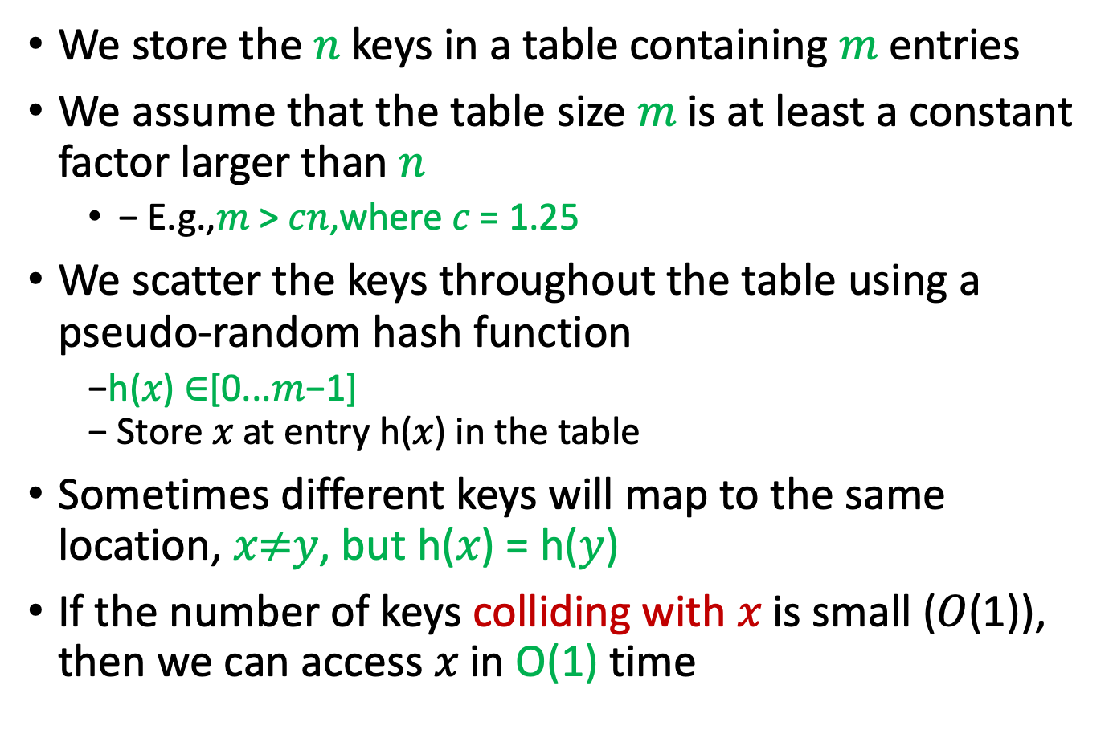
Hashing: Intuition
We store the 𝑛 keys in a table containing 𝑚 entries
We assume that the table size 𝑚 is at least a constant factor larger than 𝑛
− E.g.,𝑚 > 𝑐𝑛,where 𝑐 = 1.25
We scatter the keys throughout the table using a pseudo-random hash function
−h(𝑥) ∈[0...𝑚−1] − Store 𝑥 at entry h(𝑥) in the table
Sometimes different keys will map to the same location, 𝑥$≠$𝑦, but h(𝑥) = h(𝑦)
If the number of keys colliding with 𝑥 is small (𝑂(1)), then we can access 𝑥 in O(1) time

Slide 6
Hash Functions: Desired Properties
A good hash function h() should: − Should be efficiently computable (constant time) − Should produce few collisions
− Use every bit of the input key − Break up (scatter) naturally occurring clusters of keys
For example, keys “temp1”, “temp2”, and “temp3” should not be stored in consecutive entries of the hash table

Slide 7
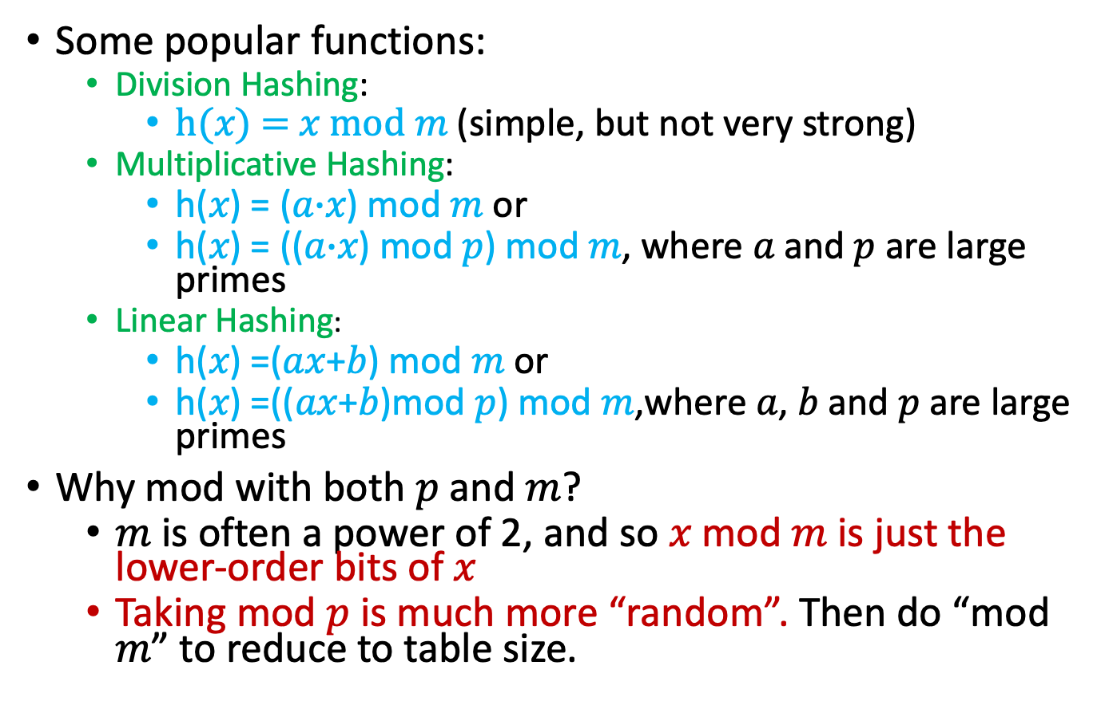
Some Popular Hashing Functions
Some popular functions:
Division Hashing:
h(𝑥) = 𝑥 mod 𝑚 (simple, but not very strong)
Multiplicative Hashing:
h(𝑥) = (𝑎$∙$𝑥) mod 𝑚 or
h(𝑥) = ((𝑎$∙$𝑥) mod 𝑝) mod 𝑚, where 𝑎 and 𝑝 are large primes
Linear Hashing:
h(𝑥) =(𝑎𝑥+𝑏) mod 𝑚 or
h(𝑥) =((𝑎𝑥+𝑏)mod 𝑝) mod 𝑚,where 𝑎, 𝑏 and 𝑝 are large primes
Why mod with both 𝑝 and 𝑚?
𝑚 is often a power of 2, and so 𝑥 mod 𝑚 is just the lower-order bits of 𝑥
Taking mod 𝑝 is much more “random”. Then do “mod 𝑚” to reduce to table size.

Slide 8
Some Popular Hashing Functions
Polynomial Hashing:
Compute a polynomial function of the key. Convenient when the key is a sequence of numbers (e.g., a character string)
For example, if k = 4 and p = 37, the associated polynomial would be h(c)=c₀ +c₁37+c₂37² + c₃37³

Slide 9
Popular Hashing Functions
Polynomial Hashing:

Slide 10
Randomization and Universal Hashing
Assuming the keys are not known in advance, no hashing function is “perfect”
collisions are inevitable
But randomness can help.
Intuition: By selecting the hash function randomly, it will be good (in expectation) for any given pair of keys
A hashing scheme is said to be universal if the hash function is selected randomly from a large class of functions, and the probability of a collision between any two fixed keys is 1/m.

Slide 11
Universal Hashing
Definition: A randomized algorithm H for constructing hash functions h : U → {0, . . . , m − 1} is universal if for all x ̸= y in U, we have
An equivalent way of looking at this. First, count the number of hash functions in H that cause a and b to collide. This is
Divide this number by |H|, the number of hash functions. This is the probability on the left hand side. So, to show universality you want

Slide 12
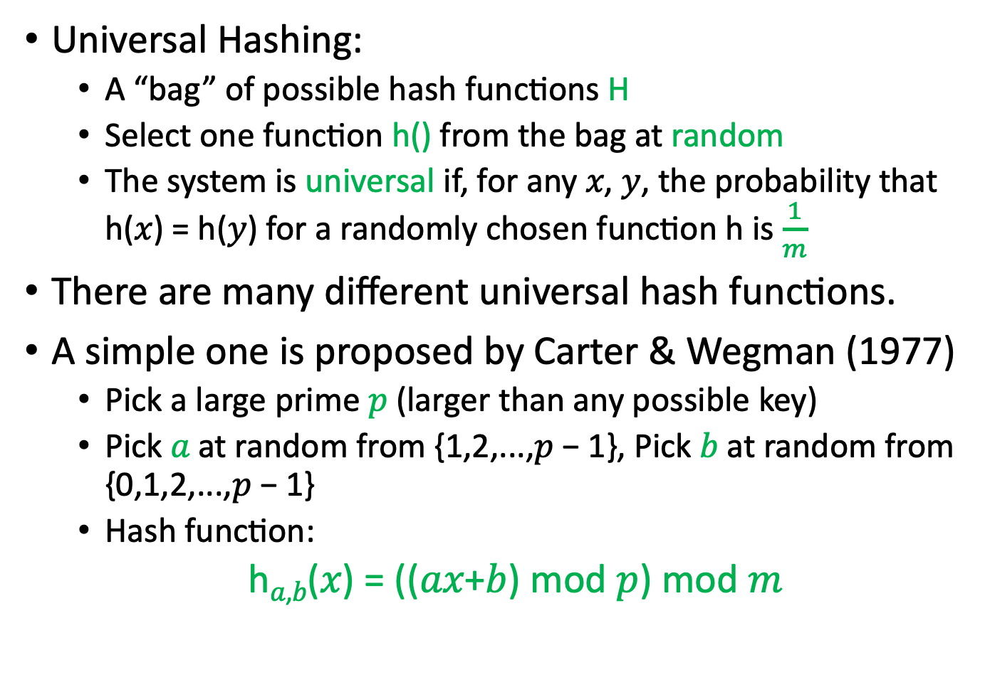
Randomization and Universal Hashing
Universal Hashing:
A “bag” of possible hash functions H
Select one function h() from the bag at random
The system is universal if, for any 𝑥, 𝑦, the probability that h(𝑥) = h(𝑦) for a randomly chosen function h is $\frac{1}{m}$
There are many different universal hash functions.
A simple one is proposed by Carter & Wegman (1977)
Pick a large prime 𝑝 (larger than any possible key)
Pick 𝑎 at random from {1,2,...,𝑝 − 1}, Pick 𝑏 at random from {0,1,2,...,𝑝 − 1}
Hash function:
h_{𝑎,𝑏}(𝑥) = ((𝑎𝑥+𝑏) mod 𝑝) mod 𝑚

Slide 13
Randomization and Universal Hashing
Theorem: Consider any two integers 𝑥 and 𝑦, where 0 ≤ 𝑦 < 𝑥 < 𝑝. Let h_{𝑎,𝑏} be a random hash function described in the previous slide. Then the probability that h_{𝑎,𝑏} (𝑥) = h_{𝑎,𝑏}(𝑦) is at most 1/𝑚.
Proof. Dave Mount CMSC420 lecture notes.

Slide 14
Universal Hashing
If H is universal, then for any set S⊆U of size N, for any x∈U (e.g., that we might want to lookup), if we construct h at random according to H, the expected number of collisions between x and other elements in S is at most N/M.

Slide 15
Summary of Popular Hash Functions
Multiplicative Hashing:
h(𝑥) = (𝑎𝑥 ) mod 𝑝 mod 𝑚 (for 𝑎 ≠ 0 and prime 𝑝)
Linear hashing:
h(𝑥) = (𝑎𝑥 + 𝑏) mod 𝑝 mod 𝑚 (for 𝑎 ≠ 0 and prime 𝑝)
−Polynomial:
𝑥= 𝑐₀,𝑐₁,𝑐₂,𝑐₃,...,
h(𝑥) =(𝑐₀+𝑐₁𝑝+𝑐₂𝑝²+𝑐₃𝑝³+⋯) mod 𝑚
− Universal hashing:
h_{𝑎,𝑏}(𝑥) = ((𝑎𝑥 + 𝑏) mod 𝑝) mod 𝑚 (where, 𝑎 and 𝑏 are random and 𝑝 is prime)

Slide 16
主要内容
Hashing
Collision resolution
Bloom Filter
Separate Chaining
Open Addressing
false positive analysis
Linear Probing
Hashing functions
Universal hashing
Quadratic Probing
Double Hashing

Slide 17
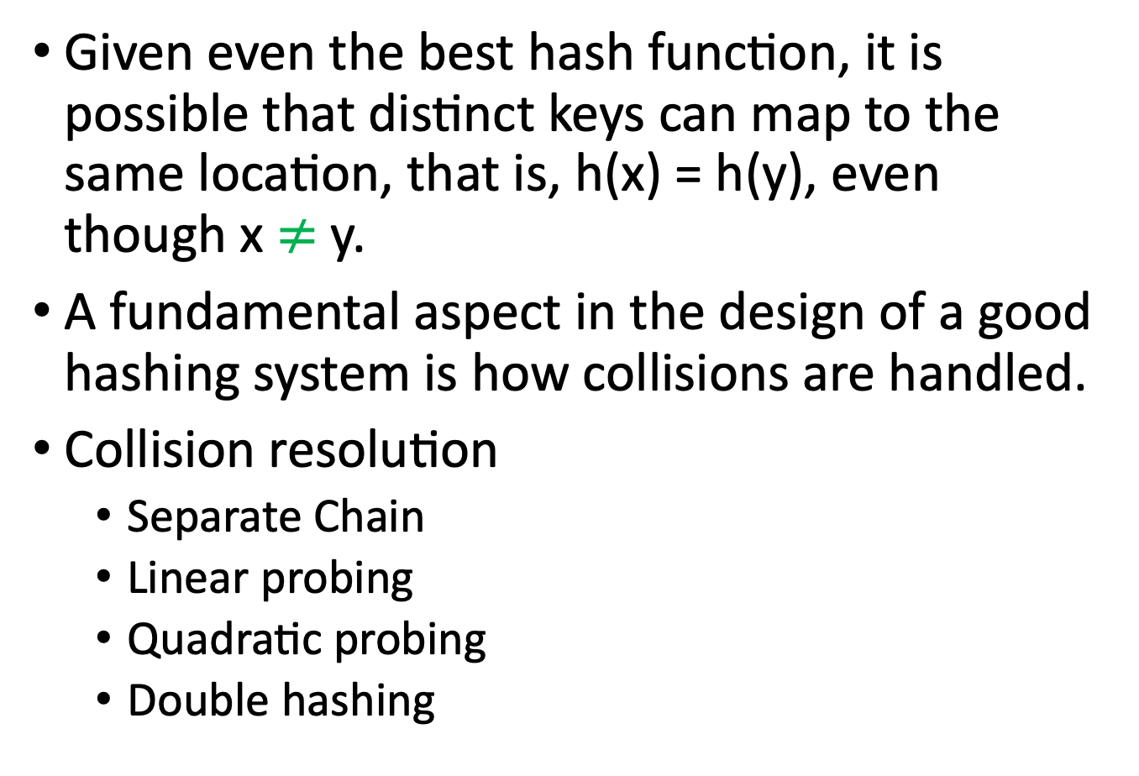
Collision Resolution
Given even the best hash function, it is possible that distinct keys can map to the same location, that is, h(x) = h(y), even though x $≠$y.
A fundamental aspect in the design of a good hashing system is how collisions are handled.
Collision resolution
Separate Chain
Linear probing
Quadratic probing
Double hashing

Slide 18
Separate Chaining
Separate chaining, is to store the colliding entries in a separate linked list
table[i] stores a linked list containing the keys 𝑥 such that h(𝑥) = 𝑖

Slide 19
Separate Chaining
Hash operations reduce to linked-list operations
insert(x, v): Compute i=h(x), invoke table[i].insert(x,v)
delete(x): Compute i=h(x), invoke table[i].delete(x)
find(x): Compute i=h(x), invoke table[i].find(x)

Slide 20
Separate Chaining
Load factor and running time
Given a hash table table[m] containing 𝑛 entries
Define load factor: 𝜆 = n/m
Assuming keys are uniformly distributed, there are on average 𝜆 entries per list
Expected search times:
Successful search (key found): Need to search half the list on average
Unsuccessful search (key not found): Need to search entire list
𝑈_{sc} =1+𝜆

Slide 21
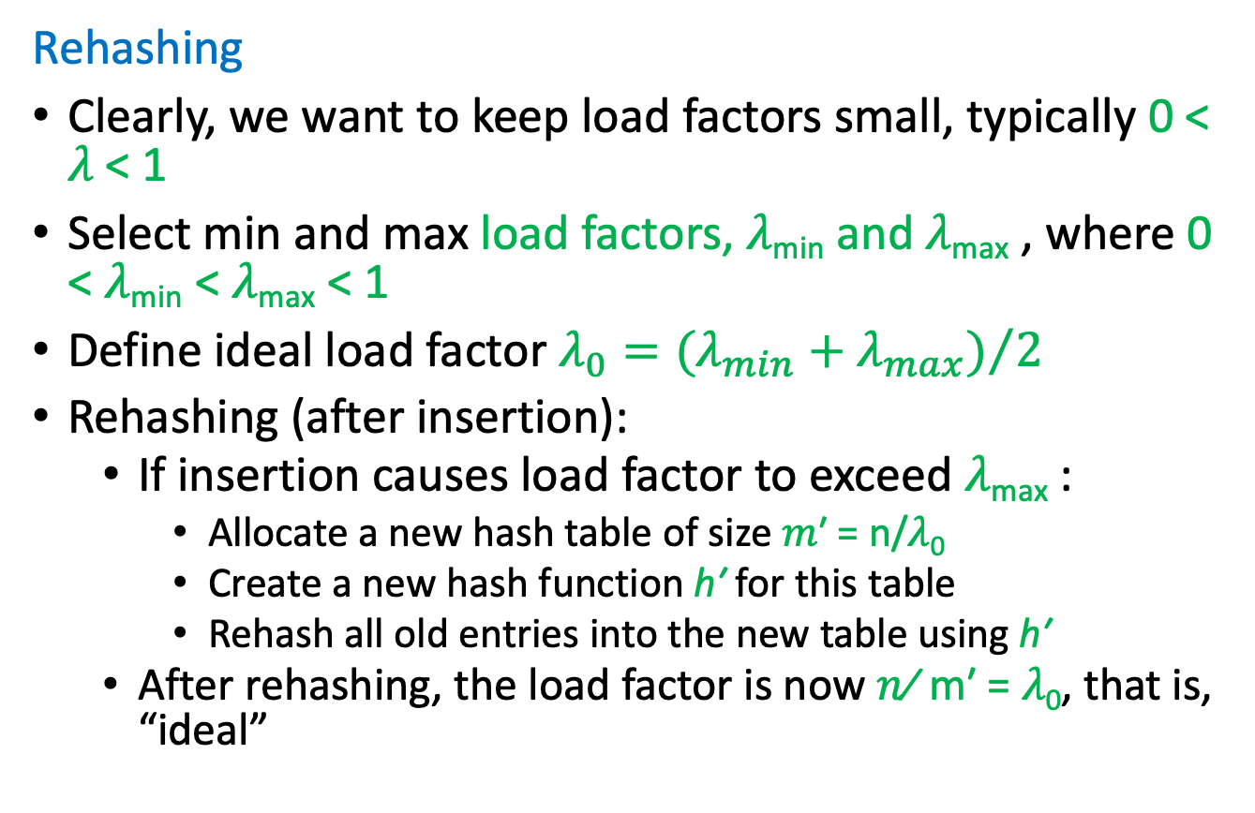
Separate Chaining
Rehashing
Clearly, we want to keep load factors small, typically 0 < 𝜆 < 1
Select min and max load factors, 𝜆_{min} and 𝜆_{max} , where 0 < 𝜆_{min} < 𝜆_{max} < 1
Define ideal load factor $λ_{0}={(λ_{min}+λ_{max})}/2$
Rehashing (after insertion):
If insertion causes load factor to exceed 𝜆_{max} :
Allocate a new hash table of size 𝑚′ = n/𝜆₀
Create a new hash function h′ for this table
Rehash all old entries into the new table using h′
After rehashing, the load factor is now 𝑛⁄ m′ = 𝜆₀, that is, “ideal”

Slide 22
Separate Chaining: Rehashing

Slide 23
Controlling the Load Factor
Underflow: Rehashing can also be applied when the load factor is too small
Rehashing (after deletion)
− If deletion causes load factor to be smaller than 𝜆_{min} :
− Allocate a new hash table of size 𝑚′ = n/𝜆₀
− Create a new hash function h′ for this table
− Rehash all old entries into the new table using h′
− After rehashing, the load factor is now 𝑛⁄m ′ = 𝜆₀, that is, “ideal”

Slide 24
Rehashing – Amortized Analysis
Whenever we rehash, the running time is proportional to the number of keys n.
If n is large, rehashing clearly takes a lot of time.
But observe that once we have rehashed, we will need to do a significant number of insertions or deletions before we need to rehash again.
The amortized cost (摊销成本) of a series of operations is the total cost divided by the number of operations.

Slide 25
Rehashing – Amortized Analysis
Rehashing takes O(n) time, but once done we are good for a while
Example:
After insertion, if 𝑛> 𝜆_{max} = 750, then we allocate a new table of size 𝑚′ = 𝑛/𝜆₀ ≈ 1500, and rehash the entries here
insertions

Slide 26
Rehashing – Amortized Analysis
Theorem: Assuming that individual hashing operations take O(1) time each, if we start with an empty hash table, the amortized complexity of hashing using the above rehashing method with minimum and maximum load factors of λ_{min} and λ_{max}, respectively, is at most 1 + 2λ_{max}/(λ_{max} − λ_{min}).
Proof:
Suppose that our most recent insertion has triggered rehashing. This implies that the current table contains roughly n ≈ λ_{max} m entries.
The last time the table was rehashed, the table contained n′ = λ₀m entries.

Slide 27
Rehashing – Amortized Analysis
This implies that we inserted at least n−n′ = (λ_{max}−λ₀)m entries.
Therefore, the number of work tokens we have accumulated since then is at least:
which implies that we have accumulated enough work tokens to pay the cost of n to rehash.
The similar proof for deletion.

Slide 28
Open Addressing
Separate chaining requires additional storage. Can we avoid this?
Store everything in the table.
Requires that 𝑛≤ 𝑚, that is, λ ≤ 1.
Open Addressing:
Special entry “empty” indicates that this table entry is unused.
To insert x, first check table[h(x)]. If empty, then store here
Otherwise, probe subsequent table entries until finding an empty location
Which entries to probe? Does it matter?
Yes! As the load factor approaches 1, some probe methods have good performance and others do not

Slide 29
Open Addressing – Linear Probing
Linear probing:
If table[h(x)] is not empty, try h(x)+1, h(x)+2, ..., h(x)+j, until finding the first empty entry
Wrap around if needed: table[(h(x)+j) % m]
Example:
Quick and dirty (maybe too quick and dirty)

Slide 30
Open Addressing – Linear Probing
Secondary clustering
Primary clustering: Clusters that occurs due to many keys hashing to the same location. (Should not occur if you use a good hash function)
Secondary clustering: Clustering that occurs because collision resolution fails to disperse (分散) keys effectively.
Bad news: Linear probing is highly susceptible to secondary clustering

Slide 31
Open Addressing – Linear Probing
Expected Search Time
The proof is quite sophisticated, and we will skip it.
A rule of thumb is that as long as the table remains less than 75% full, linear probing performs fairly well.
the issue of secondary clustering is a major shortcoming.

Slide 32
Open Addressing – Quadratic Probing
Use a nonlinear probing function which scatters subsequent probes around more effectively

Slide 33
Open Addressing – Quadratic Probing
Rather than computing h(x)+i², we use a cute trick to update the probe location.
Observe that i² = (i − 1)² + 2i − 1
(i²) is obtained by incrementing the old position ((i − 1)²) by the value 2i − 1.

Slide 34
Open Addressing – Quadratic Probing
More formally, the probe sequence is h(𝑥) + 𝑓(𝑖), where 𝑓(𝑖) = 𝑖²
Complete coverage?
− Does the probe sequence hit every possible table location?
− No! For example, if 𝑚=4, 𝑖² mod 4 is either 0 or 1,never 2 or 3.
Any hope? Can we select 𝑚 so that quadratic probing hits all entries?
If 𝑚 is prime of the form 4𝑘 + 3, quadratic probing will hit every table entry before repeating.
If the table size m is a power of two, and the increment is chosen to be 1/2 (i² + i), then you will succeed in probing every table entry before repeating an entry.
(source: Wikipedia)

Slide 35
Open Addressing – Quadratic Probing
Theorem: If quadratic probing is used, and the table size m is a prime number, the first ⌊m/2⌋ probe sequences are distinct.
Proof: Suppose by way of contradiction that for 0 ≤ i < j ≤ ⌊m/2⌋, both h(x) + i² and h(x) + j² are equivalent modulo m. Then the following equivalencies hold modulo m:
This means that the quantity (i − j)(i + j) is a multiple of m, which requires both (i-j) and (i+j) are multiple of m.
i < j ≤ ⌊m/2⌋ implies that their sum is strictly smaller than m
(i − j)(i + j) cannot be a multiple of m.

Slide 36
Open Addressing – Double Hashing
Linear probing suffers from secondary clustering
Quadratic probing may fail to hit all cells
Double hashing:
Probe offset is based on a second hash function 𝑔(𝑥).
Probe sequence: h(𝑥), h(𝑥) + 𝑔(𝑥), h(𝑥) + 2𝑔(𝑥), h(𝑥) + 3𝑔(𝑥), ...

Slide 37
Open Addressing – Double Hashing
Will this hit all entries before cycling?
In order to be sure that we do not cycle, it should be the case that m and g(x) are relatively prime, that is, they share no common factors.
For example, we could adjust the table size so that m is always prime, and then we are free to select g(x).
Alternately, we could be careful in the choice of g(x) so that it is prime, and then we could make m arbitrary.
We should be careful in the design of a double-hashing scheme, but there is a lot of room for adjustment.

Slide 38
Open Addressing – Double Hashing

Slide 39
Open Addressing – Double Hashing
Double hashing has the best search times among all the methods covered so far:
Expected time of successful search:
Expected time of unsuccessful search
These search times depend only on the load factor, not n.

Slide 40
Open Addressing – Deletion
Deleted entries can create the illusion we are at the end of the probe sequence

Slide 41
Open Addressing – Deletion
Special entry “deleted”: The item at this location has been deleted
− When searching: don’t stop here
− When inserting: a key can be placed here

Slide 42
Hashing – Further Refinements
Numerous refinements have been proposed
Example: Brent’s Method
When using double hashing, multiple probe sequences (with different values of g(x)) may overlap at a common cell of the hash table, say table[i]
If one of these probe sequences is significantly longer than the other, we can reduce the average search time by changing which key is placed at this point of overlap.
Brent’s algorithm optimizes this selection of which keys occupy these locations in the hash table.

Slide 43
Summary
Separate Chaining
Open Addressing – Linear Probing
Open Addressing – Quadratic Probing
Open Addressing – Double Hashing
𝑈_{sc} =1+𝜆

Slide 44
Summary
Separate Chaining - Easy to implement - Running times O(1 + λ)
Open Addressing Various schemes:
Linear Probing – easiest, but need to resize most frequently
Quadratic Probing – middle ground
Double Hashing – need a whole new hash function, but low chance of clustering.
Which you use depends on your application and what you’re worried about.

Slide 45
主要内容
Hashing
Collision resolution
Bloom Filter
Separate Chaining
Open Addressing
false positive analysis
Linear Probing
Hashing functions
Universal hashing
Quadratic Probing
Double Hashing

Slide 46
Bloom Filter
Approximate set membership problem .
Trade-off between the space and the false positive probability .
Generalize the hashing ideas.
应用举例
拼写检查，字典中的单词插入布隆过滤器中，对输入的单词进行检查，返回no，则提示拼写错误。
禁用密码，所有的禁用密码插入布隆过滤器中，如果对输入的密码检查时返回yes，则要求用户重新输入。
Internet路由器，将禁止的地址放入布隆过滤器，如果查询返回yes，则重新进行路由选址。

Slide 47
Approximate set membership problem
Suppose we have a set
S = {s₁,s₂,...,s_{n}} ⊆ universe U
Represent S in such a way we can quickly answer “Is x an element of S ?”
To take as little space as possible ,we allow false positive (i.e. x∉S , but we answer yes )
If x∈S , we must answer yes .

Slide 48
Bloom filters
Consist of an arrays A[m] of m bits (space) , and k independent random hash functions
h₁,…,h_{k} : U --> {0,1,..,m-1}
1. Initially set the array to 0，save S into Bloom Filter
2. ∀ s∈S, A[h_{i}(s)] = 1 for 1≤ i ≤ k
(an entry can be set to 1 multiple times, only the first times has an effect )
x₁
x₂
0
0
0
0
0
0
0
0
0
0
0
0
1
1
1
1
1
Each element of S is hashed k times
Each hash location set to 1

Slide 49
Query in Bloom Filter
3. To check if x∈S , we check whether all location A[h_{i}(x)] for 1≤ i ≤ k are set to 1
If not, clearly x∉S.
If all A[h_{i}(x)] are set to 1 ,we assume x∈S
y
0
0
0
1
0
0
1
0
1
0
0
0
1
0
0
1
0
If only 1s appear, conclude that y is in S
This may yield false positive

Slide 50
Query in Bloom Filter
3. To check if x∈S , we check whether all location A[h_{i}(x)] for 1≤ i ≤ k are set to 1
If not, clearly x∉S.
If all A[h_{i}(x)] are set to 1 ,we assume x∈S
y
0
0
0
1
0
0
1
0
1
0
0
0
1
0
0
1
0
To check if y is in S, check the k hash
location. If a 0 appears , y is not in S

Slide 51
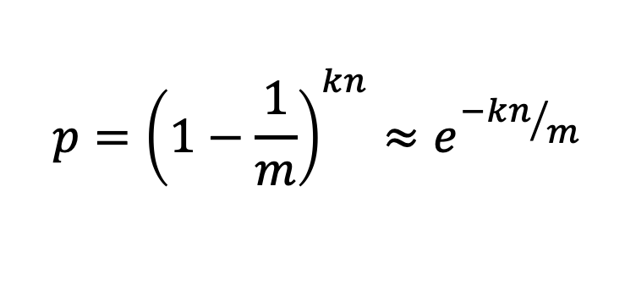
The probability of a false positive
We assume the hash function are random.
After all the elements of S are hashed into the bloom filters, the probability that a specific bit is still 0 is:
where
m: space length in the bloom filter
k: number of Hash functions
n: number of elements stored in S.
$$p={\left(1−\frac{1}{m}\right)}^{kn}≈e^{{−kn}/m}$$
kn次的存储都存在了另外m-1位

Slide 52
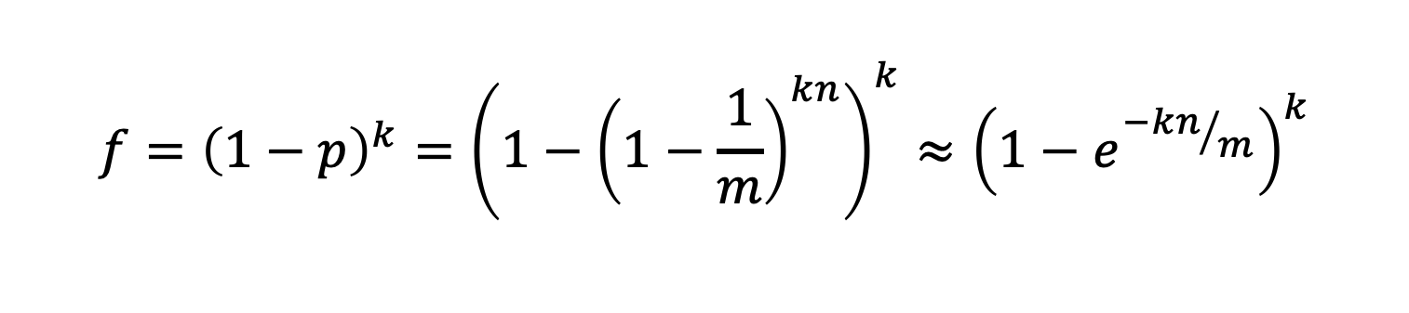
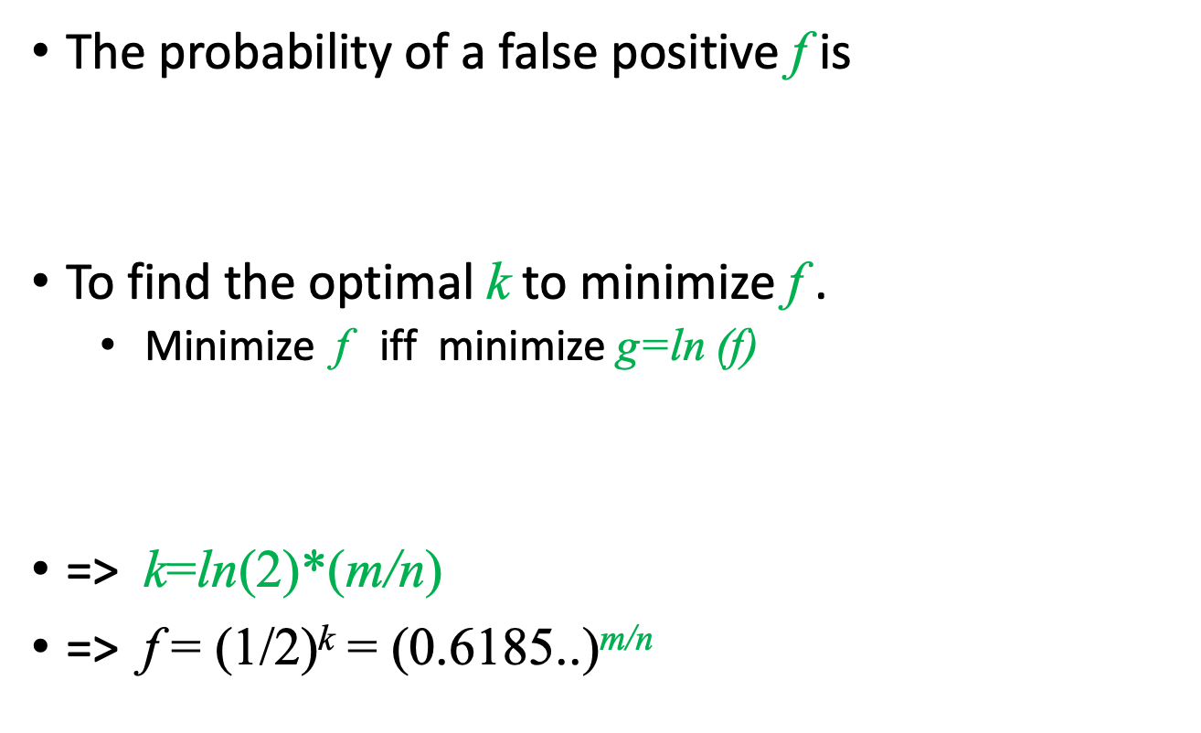
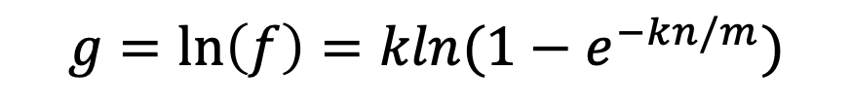
The probability of a false positive
The probability of a false positive f is
To find the optimal k to minimize f .
Minimize f iff minimize g=ln (f)
=> k=ln(2)*(m/n)
=> f = (1/2)^{k} = (0.6185..)^{m/n}
$$f={{\left(1−p\right)}^{k}=\left(1−{\left(1−\frac{1}{m}\right)}^{kn}\right)}^{k}≈{\left({1−e}^{{−kn}/m}\right)}^{k}$$
$$g=\ln\left(f\right)=kln(1−e^{−kn/m})$$
m: space length
n: number of elements stored in S.
The false positive probability falls exponentially in m/n !!

Slide 53
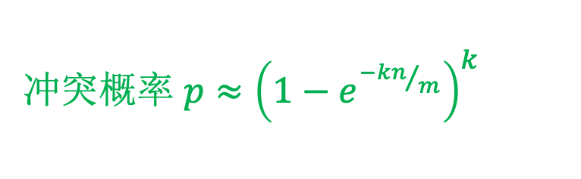
布隆过滤器分析
冲突概率 $p≈{\left({1−e}^{{−kn}/m}\right)}^{k}$
n = 1 billion, m = 8 billion
k = 1: (1 – e^{-1/8}) = 0.1175
k = 2: (1 – e^{-1/4})² = 0.0493
增加k会发生什么情况?
k最优解: m/n ln(2)
In our case: 最优 k = 8 ln(2) = 5.54 ≈ 6
误差 = 6: (1 – e^{-1/6})² = 0.0235
假设要求误差概率不超过0.1%，那么我们需要设m=14.4*n，即每个元素需要15个比特
False positive
Number of hash functions, k

Slide 54
Summary of Bloom Filter
A Bloom filters is like a hash table, and simply uses one bit to keep track whether an item hashed to the location.
If k=1, it’s equivalent to a hashing based fingerprint system.
If m=cn for small constant c, such as c=8 ,then k=5 or 6, the false positive probability is just over 2% .
It’s interesting that when k is optimal k=ln(2)*(m/n)
An optimized Bloom filters looks like a random bit-string

Slide 55
布隆过滤器究竟有什么优势呢？
相比普通Hash表的优势
但hash表本质上是指针数组，现在每个指针占64bit，存储n个元素，约需要 80n bits
Bloom filter 在允许误报1%的错误了的话，m约等于10n，节省存储空间
自带隐私保护功能
全部存储但是不存储数据本身，适合有保密要求的场景
常数插入和查询时间
插入和查询时间复杂度都是 O(k), 不会随着元素增加而增加，远超一般算法。

Slide 56
Recap
Popular Hash Functions
Multiplicative Hashing:
h(𝑥) = (𝑎𝑥 ) mod 𝑝 mod 𝑚 (for 𝑎 ≠ 0 and prime 𝑝)
Linear hashing:
h(𝑥) = (𝑎𝑥 + 𝑏) mod 𝑝 mod 𝑚 (for 𝑎 ≠ 0 and prime 𝑝)
−Polynomial:
𝑥= 𝑐₀,𝑐₁,𝑐₂,𝑐₃,...,
h(𝑥) =(𝑐₀+𝑐₁𝑝+𝑐₂𝑝²+𝑐₃𝑝³+⋯) mod 𝑚
− Universal hashing:
h_{𝑎,𝑏}(𝑥) = ((𝑎𝑥 + 𝑏) mod 𝑝) mod 𝑚 (where, 𝑎 and 𝑏 are random and 𝑝 is prime)

Slide 57
Collision resolution
Separate Chaining
Open Addressing – Linear Probing
Open Addressing – Quadratic Probing
Open Addressing – Double Hashing
𝑈_{sc} =1+𝜆

Slide 58
Universal Hashing
Definition: A randomized algorithm H for constructing hash functions h : U → {0, . . . , m − 1} is universal if for all x ̸= y in U, we have
An equivalent way of looking at this. First, count the number of hash functions in H that cause a and b to collide. This is
Divide this number by |H|, the number of hash functions. This is the probability on the left hand side. So, to show universality you want

Slide 59
Rehashing – Amortized Analysis
Theorem: Assuming that individual hashing operations take O(1) time each, if we start with an empty hash table, the amortized complexity of hashing using the above rehashing method with minimum and maximum load factors of λ_{min} and λ_{max}, respectively, is at most 1 + 2λ_{max}/(λ_{max} − λ_{min}).
Proof:
Suppose that our most recent insertion has triggered rehashing. This implies that the current table contains roughly n ≈ λ_{max} m entries.
The last time the table was rehashed, the table contained n′ = λ₀m entries.

Slide 60
Summary of Bloom Filter
A Bloom filters is like a hash table ,and simply uses one bit to keep track whether an item hashed to the location.
If k=1 , it’s equivalent to a hashing based fingerprint system.
If n=cm for small constant c, such as c=8 ,then k=5 or 6, the false positive probability is just over 2% .
It’s interesting that when k is optimal k=ln(2)*(n/m)
An optimized Bloom filters looks like a random bit-string

Slide 61

Thanks.
We turn to graphs in the next lecture.

